Slide 1
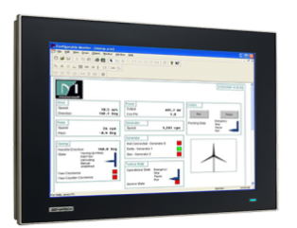
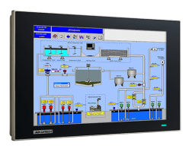
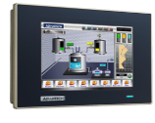
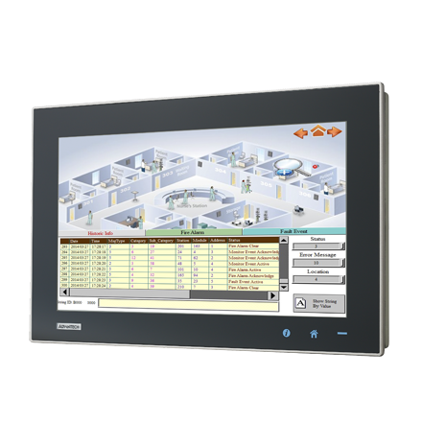
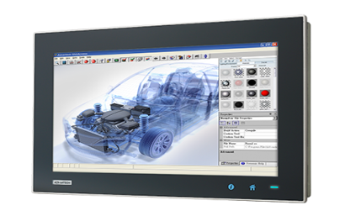
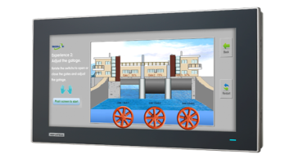
FPM-7000 series
FPM-7000W 16:9 Wide Screen Industrial Monitor
FPM-7000T 4:3 Wide Temperature Industrial Monitor
FPM-7000T Series (15”/ 12.1”/ 6.5”)
FPM-7000W Series
(15.6”/ 18.5”/ 21.5”)

Slide 2
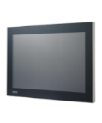
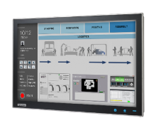
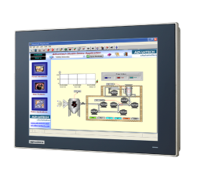
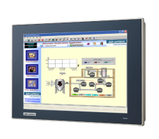
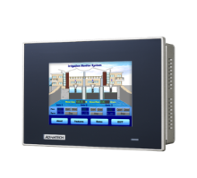
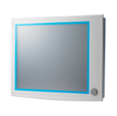
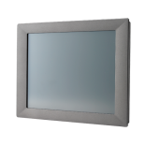
Industrial Monitor Family
Positioning
Value Proposition / Messages
16:9 wide screen display, PCT multi touch
i-Link technology for long-distance and daisy chain routing
Thin side bars and thinnest mechanical design in industry with IP65 protection
i-Keys for on screen display adjustment
Wide screen
Multi-touch
Long-distance Solution
16:9 PCT
-20~60 wide working temperature support
Robust mechanical design with high reliable components
IP65/66 mechanical design
Dual power support, both 12VDC and 24VDC
Robust
wide temperature
Rugged
Cost effective solutions
Compact design
Single power support 12VDC or 24VDC
Cost effective
Entry Level

Slide 3
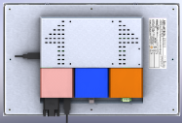
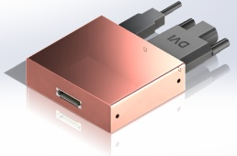
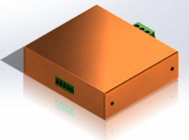
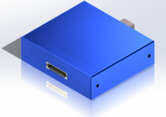
Roadmap for Industrial Monitor
Available
Developing
Planning
Modularize &Web Terminal System
PIP
AP/Wifi
2016/Q3
2017/Q2
FPM-1211W
Web Terminal System
2016/Q3
Video Signal / iLink Box
RISC BOX
Modularize Box
VGA/DVI/DP/HDMI Box
Long distance iLink Rx
Modularize Box
TI Cortex-A8 processor on board
Fanless cooling system 
Built-in micro SD card & Win CE OS 
Modularize Monitor
Flexible Video Signal
Long distance up to 100m
PIP & AP/Wifi function
Support RISC System
Wide screen 16:9
Web Terminal System
FPM 7000
High Performance
FPM-7151W/7181W/7211W
FPM-7121T/FPM-7151T/FPM-7061T
Model 6.5” 12”, 15”
Model 18.5”, 21.5” wide screen
Operating Temp: 0~50 Degree
Dual Power input
VGA/DVI/ VGA/DP, USB T/S input
Wide screen 16:9
Multi-touch
True-flat 4:3 FPM
IP66 upgrade
FPM 2000/5000
Entry-Level
FPM-5151G/5171G/FPM-5191G
FPM-5152G/5171G/FPM-5192G
Model 15”, 17”, 19”
Operating Temp: 0~50 Degree
Dual Power, Video (VGA/DVI), T/S input
Industrial Grade Monitor
& DP port selection
FPM-2120G/2150G/FPM-2170G
Model 12”, 15”, 17”
Operating Temp: 0~50 Degree
12 VDC, VGA , Dual T/S input
Entry level Best Choice
Released
2016
Notes:
FPM-7000 21吋賣600多台/18.15銷售少

Slide 4
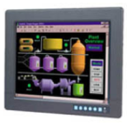
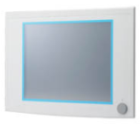
General Industrial Monitors
FPM-3121G/3151G/3191G
FPM-7000 series
12”/15”/17” with Resistive Touch
Reliable bezel and rear cover design
Ground isolation protection
Front accessible OSD
VGA/DVI/USB Touch
Support -20-60 ℃
6”/12”/15” with Resistive Touch
15.6/18.5/21.5 with PCT
Truly flat touch screen
Multi-touch support
VGA/DVI or VGA/DP
-20-60 ℃for T-series
0-50 ℃for Widescreen
High Performance
Cost effective
FPM-2120G / 2150G / 2170G
FPM-5151G/5171G/5191G
12”/15”/17” with Resistive Touch
Aluminum front bezel
SECC rear cover
VGA/Comport Touch
Support 0-50 ℃
15”/17”/19” with Resistive Touch
Front accessible USB connector
Anti-rusting coating
VGA/DVI/USB Touch
0-50 ℃

Slide 5
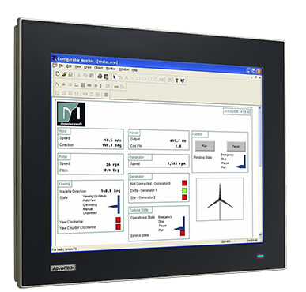
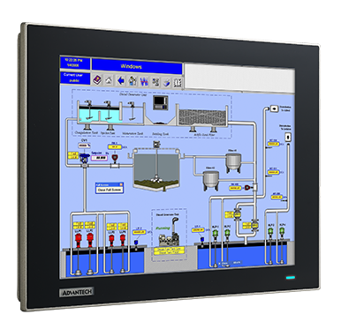
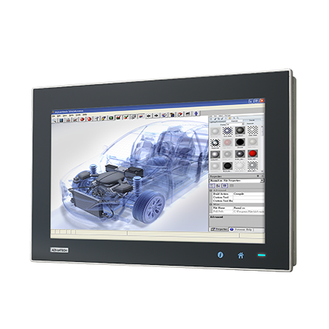
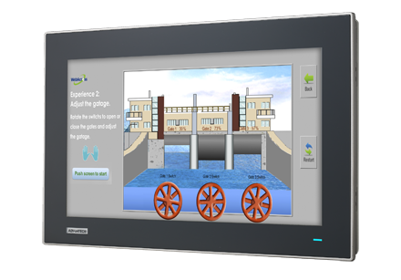
FPM-7000 series - iF Product design Awarded
Leveraging TPC design, Awarded with the iF design awards 2013, out of total 4,352 entries
FPM-7000T Series (15”/ 12.1”/ 6.5”)
FPM-7000W Series
(15.6”/ 18.5”/ 21.5”)

Slide 6
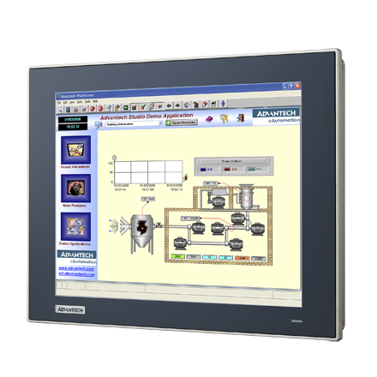
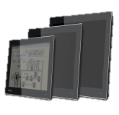
FPM-7000T
4:3 Wide Temp Industrial Monitor
Notes:
In this month, WA+ team will launch new WebAccess version – V7.2
There are five new features provided in WebAccess V7.2:
Support Multi-touch Gesture
GPS Location Tracking on Google Maps
Express Function Enhancement
Support IPv6
APAX KW Data Integration

Slide 7
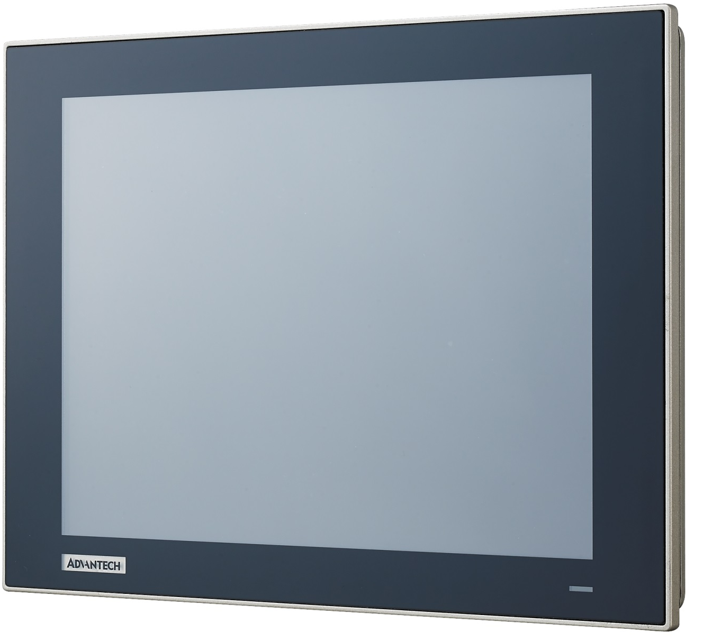
Features-Front
5-wire Resistive Touch
More reliable
Anti-glare solution
Chemical resistant for general cleansing
Industrial Grade LCD
50,000hrs life time
VGA for 5.7”,
XGA for 12” & 15”
Wide temperature supports -20~60
True Flat Design
IP66
Easy maintenance
LED power indicator
Logo Design
Logo with transparent background for layered look
Customizable
On
Off

Slide 8
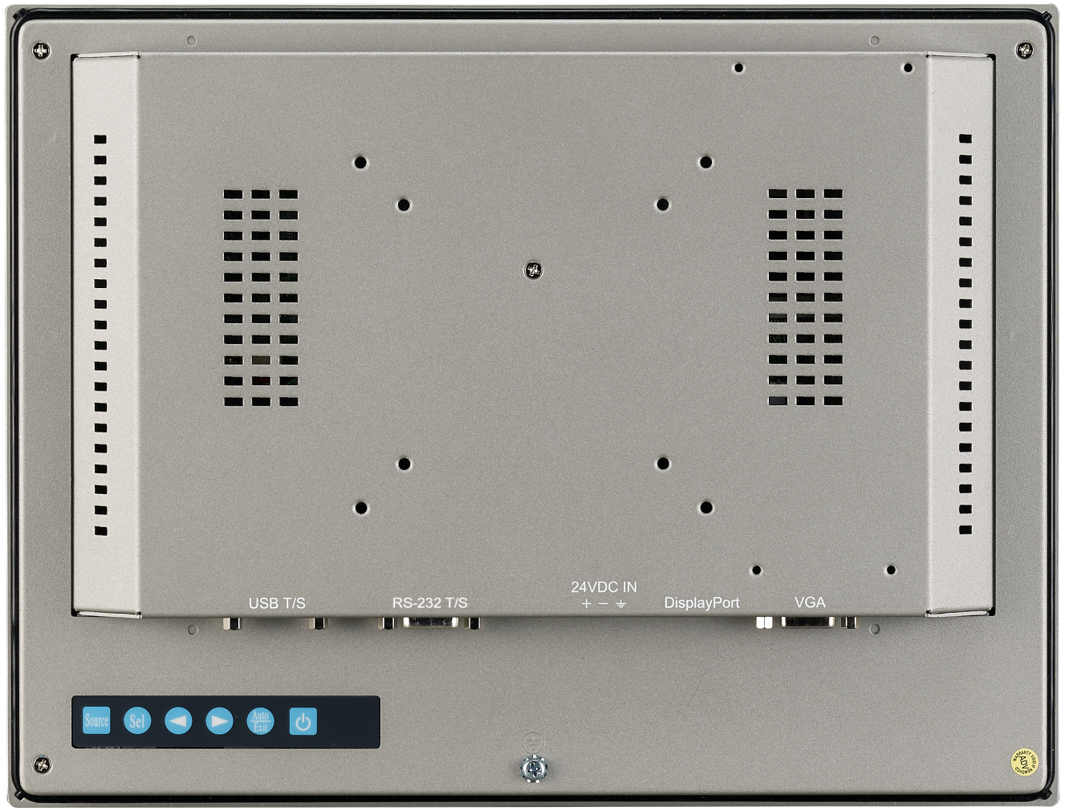
Features-Rear
VESA mount
75 x 75 & 100 x 100mm VESA mount holes
Adapter Mounting
Attach adapter directly to the rear cover
O-ring rubber
Secure system and cabinet attachment while panel mounting
Ground Cable
Attach ground cable for ESD protection
OSD Control Pad
Various functions adjustable

Slide 9
Features-Downward
Cut-out Dimension
Same dimensions with TPC-xx51T series
Panel Mount Holes
Clamper & screws are included
Lockable Touch Interface
Secure cables connection to the system
Combo for 12”, 15”, 17”
USB for 6.5”
24VDC power input
Lockable design
Secure cables connection to the system
VGA/DP Video Ports
Combo video input interfaces
VGA/HDMI ADB available for customisation

Slide 10
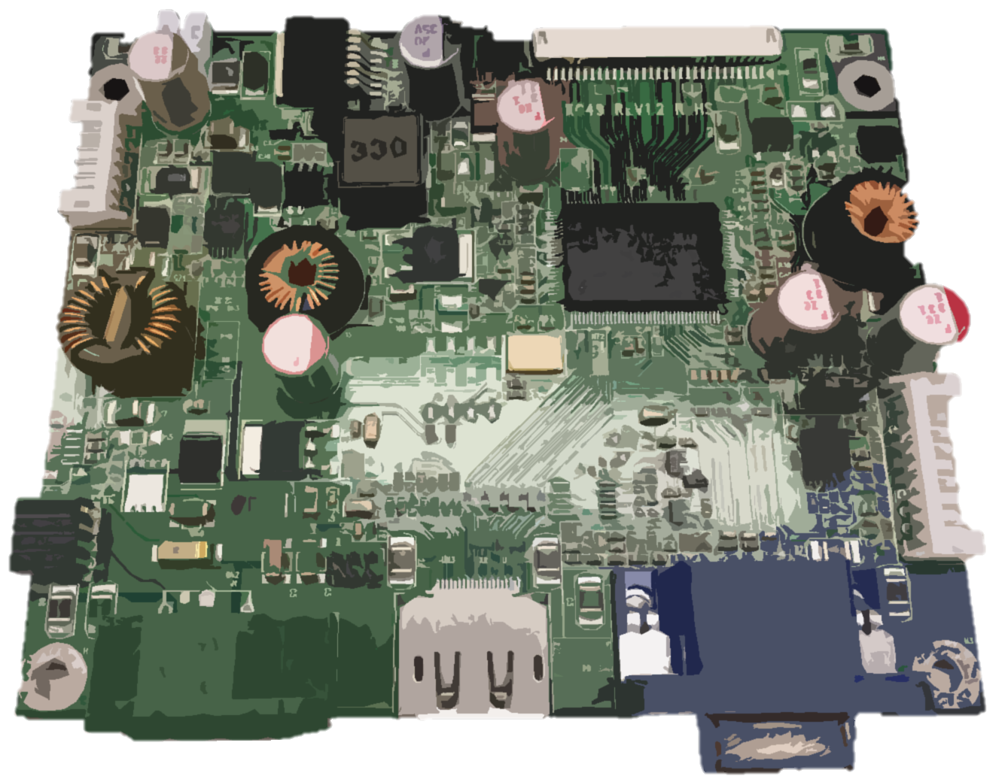
Features-Heart
Strick Components Selection
Wide temperature support components & cables
Solid electrolytic Capacitors for long life, higher reliability
Reverse Polarity Protection
Protection covering range around 32VDC
OVP/UVP Protection
Over voltage protection until 32VDC
UVP to keep system stable
VGA/DP Video Ports
VGA/HDMI ADB available for customisation

Slide 11
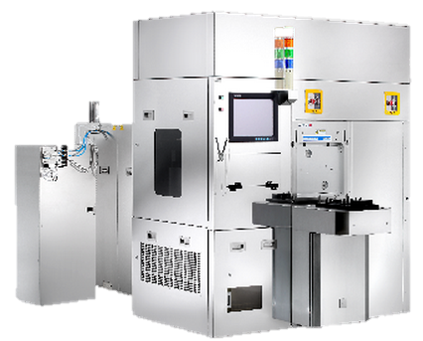
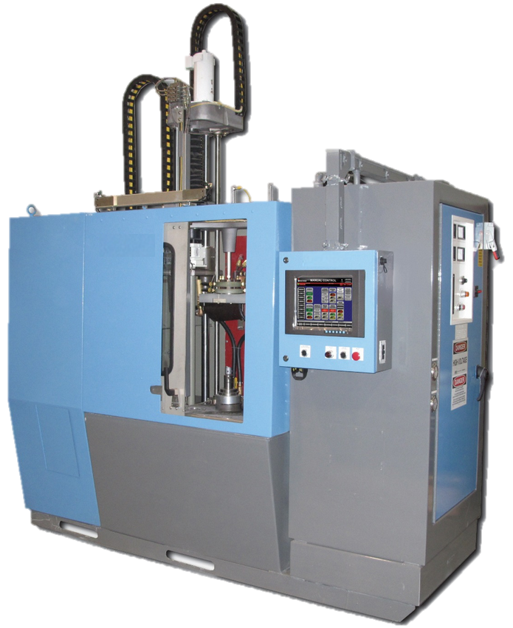
Applications (Wide tempt./IP66)
Heating System
Wide temperature support suitable for heating process
Oven, Semi-conductor
Wide temperature support suitable for baking process
High-tempt. Food Processing
Wide temperature support suitable for high-tempt. process
IP66 suitable for cleaning

Slide 12
FPM-7000T series
Model |  | FPM-7061T | FPM-7121T | FPM-7151T
Display | Display Type | XGA | WXGA | Full HD
 | Display Size | 6.5" | 18.5" | 21.5"
 | Max.Resolution | 640 x 480 | 1366 x 768 | 1920x1080
 | Max.Colors | 262K | 16.7M | 16.7M
 | Luminance cd/m2 | 800 | 300 | 300
 | Viewing Angle(H/V°) | 160/140 | 170/160 | 178/178
 | Backlight MTBF(hrs) | 50,000 | 50,000 | 50,000
Video Port |  | VGA/DP | VGA/DP | VGA/DP
Touchscreen |  | USB | Combo | Combo
OSD(onscreen display) |  | On rear side with lockable function | On rear side with lockable function | On rear side with lockable function
Power Input Voltage |  | 100~240v (Adapter) | 100~240v (Adapter) | 100~240v (Adapter)
DC Power Input(voltage) |  | 12v/24v | 12v/24v | 12v/24v
Operating Temperature |  | -20~60 | -20~60 | -20~60
Storage Temperature |  | -30~70 | -30~70 | -30~70
Dimension |  | 311.80 x 238 x 57.2 mm | 311.8 x 238 x 44.6 mm | 383.2 x 307.3 x 48.2 mm
Cut-out Dimension |  | 189.1 x 142.1 mm | 301.6 mm x 227.6 mm | 372.9 mm x 296.9 mm
Weight |  | 1.2kg | 2.6kg | 4.2kg
Ordering Info |  | FPM-7061T-R3AE 6.5" XGA Ind Monitor w/Resistive TS (VGA/DP) | FPM-7121T-R3AE 12.1" XGA Ind Monitor w/Resistive TS (VGA/DP) | FPM-7151T-R3AE 15" XGA Ind Monitor w/Resistive TS (VGA/DP)

Slide 13
FPM-7000W
16:9 Wide screen
Industrial Monitor
Notes:
In this month, WA+ team will launch new WebAccess version – V7.2
There are five new features provided in WebAccess V7.2:
Support Multi-touch Gesture
GPS Location Tracking on Google Maps
Express Function Enhancement
Support IPv6
APAX KW Data Integration

Slide 14
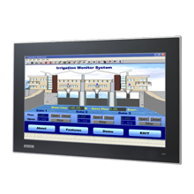
Optimized Ratio Wide Screen with True flat
Slim, Simple and Low profile
Optimized Ratio Wide screen – 16:9
Entirely True Flat panel, easy to clean
Compliant to IP66 front panel design
Light yet Robust aluminum die-cast front bezel
Notes:
Advantech Touch panel computer is designed Slim, Simple and Low profile because the Enclosure is Aluminum alloy in Front bezel and also fanless designed .
The model is designed Entirely True Flat panel, and is easy to clean. The true flat front panel is Compliant to IP66 standard, able to protect against powerful water jets.

Slide 15
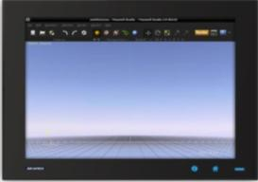
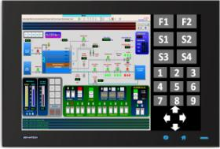
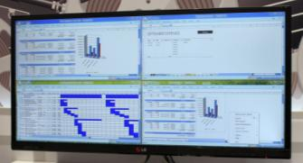
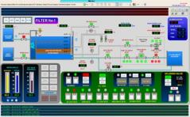
Why Wide Screen - Optimize Ratio
Easy View
Easier to view some computer programs
Less Eyestrain
Space
More Space
Increase 40 % Space
large spreadsheets and graphic design applications
Keep Several Windows Open
Increase 40 % Space
More Space for Operation Button
Several Windows Open
Notes:
The second features, wide screen panel.
Why develop the widescreen touch panel? Widescreen is the market trend for Optimize Viewing application.
Viewing Programs is Easier with widescreen
Wide-screen monitors make it easier to view some computer programs, especially large spreadsheets and graphic design applications. Having more 40% space on the screen means you won't have to scroll to read two pages side by side. Wide-screen monitors allow graphic designers to work in a higher resolution and see more of their image at once
Less Eyestrain
Many wide-screen monitors offer a high-clarity image that reduces eyestrain. They may enable you to work for a longer amount of time before you take a break.
Keeping Several Windows Open
Wide-screen monitors make it easier to work with several windows open at one time, without having to resize the windows.
This can make work easier and more efficient for many people.

Slide 16
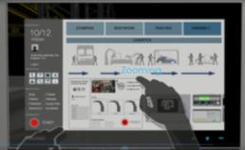
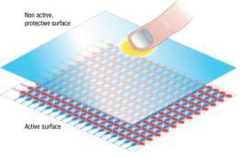
Projected Capacitive Multi-Touch
Sensitive Touch used in Smartphone and tablet
Higher Durability
7H Glass
Scratch & Chemical Resistance
Avoid inappropriate usage
Coating to avoid Reflective
Support 1mm Glove or PCT Glove
Support Multi-touch
Notes:
The third features is Projected Capacitive Multi-Touch
The model use the Sensitive Touch Projected Capacitive Multi-Touch, which often used in Smartphone and tablet
The Touch is Higher Durability with 7H glass and can adorable Scratch & Chemical Resistance, Avoid inappropriate usage, and Coating to avoid Reflective
Projected Capacitive touch also support operate with 1mm Glove or PCT Glove. And if the panel has the water drop, the touch function is available.

Slide 17
FPM-7000W series Spec
Model |  | FPM-7151W | FPM-7181W | FPM-7211W
Display | Display Type | WXGA | WXGA | Full HD
 | Display Size | 15.6" | 18.5" | 21.5"
 | Max.Resolution | 1366 x 768 | 1366 x 768 | 1920x1080
 | Max.Colors | 16.7M | 16.7M | 16.7M
 | Luminance cd/m2 | 300 | 300 | 300
 | Viewing Angle(H/V°) | 170/160 | 170/160 | 178/178
 | Backlight MTBF(hrs) | 50,000 | 50,000 | 50,000
Video Port |  | VGA/DVI-D or VGA/HDMI | VGA/DVI-D | VGA/DVI-D
Touchscreen |  | Combo | Combo | Combo
OSD(onscreen display) |  | On rear side with lockable function | On rear side with lockable function | On rear side with lockable function
Power Input Voltage |  | 100~240v (Adapter) | 100~240v (Adapter) | 100~240v (Adapter)
DC Power Input(voltage) |  | 12v/24v | 12v/24v | 12v/24v
Operating Temperature |  | 0 ~ 50 | 0 ~ 50 | 0 ~ 50
Storage Temperature |  | -20~60 | -20~60 | -20~60
Dimension |  | 419.7x269x47.7mm | 488x309x47.7mm | 558.4x349.8x47.7mm
Cut-out Dimension |  | 412.4x261.7mm | 479x300mm | 550.5x345.2mm
Weight |  | 5kg | 6kg | 8kg
Ordering Info |  | FPM-7151W-P3AE 15.6" WXGA Ind Monitor w/PCT TS (VGA/DVI) | FPM-7181W-P3AE 18.5" WXGA Ind Monitor w/PCT TS (VGA/DVI) | FPM-7211W-P3AE 21.5" Full HD Ind Monitor w/PCT TS (VGA/DVI)

Slide 18
Mounting and Accessories
Panel Mount
Desktop Stand
Arm Mount
Rack Mount
VESA Mount (100mm)
Notes:
In this month, WA+ team will launch new WebAccess version – V7.2
There are five new features provided in WebAccess V7.2:
Support Multi-touch Gesture
GPS Location Tracking on Google Maps
Express Function Enhancement
Support IPv6
APAX KW Data Integration

Slide 19
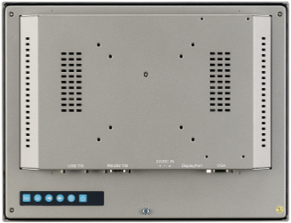
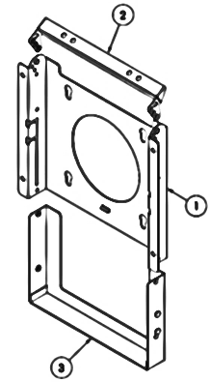
Features-Mounting Support
Panel Mount (FPM all Series)
Desktop Stand (FPM-1000T-SMKE)
Arm Mount (Via VESA hole)
Rack Mount FPM-3000G Series FPM-5000G Series
VESA Mount 75mm and/or 100mm (FPM all Series)
 | Panel Mount | Rack Mount | Stand Mount | Adapter | VESA
FPM-7061T | Included | No Support | Optional FPM-1000T-SMKE | Optional | 75 * 75 mm
FPM-7121T | Included | No Support | Optional FPM-1000T-SMKE | Optional | 75 * 75 mm 100*100 mm
FPM-7151T | Included | No Support | Optional FPM-1000T-SMKE | Optional | 75 * 75 mm 100*100 mm
FPM-7151W | Included | No Support | Optional FPM-1000T-SMKE | Optional | 75 * 75 mm 100*100 mm
FPM-7181W | Included | No Support | Optional FPM-1000T-SMKE | Optional | 75 * 75 mm 100*100 mm
FPM-7211W | Included | No Support | Optional FPM-1000T-SMKE | Optional | 75 * 75 mm 100*100 mm

Slide 20
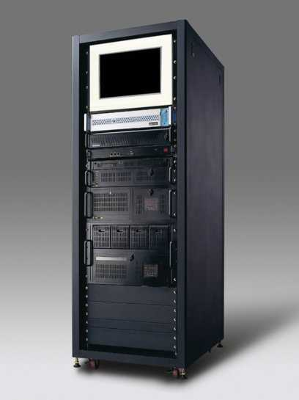
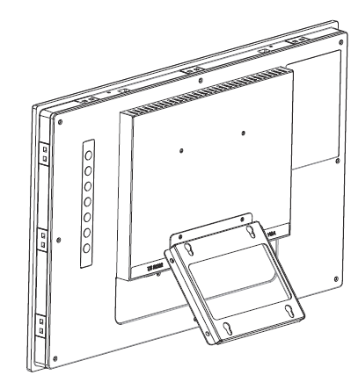
Mounting Selection
Panel Mount
Desktop Stand
Arm Mount
Rack Mount
VESA Mount (100mm)
One-person easy installation by special snap
Optional FPM-7181W-SMKE
Wall Mount

Slide 21
Ordering
Information
Notes:
In this month, WA+ team will launch new WebAccess version – V7.2
There are five new features provided in WebAccess V7.2:
Support Multi-touch Gesture
GPS Location Tracking on Google Maps
Express Function Enhancement
Support IPv6
APAX KW Data Integration

Slide 22
Naming Rule
Version
FPM – 7 15 1 W – P 3 A E
RoHS
Series Definition
2000/3000/5000/7000/8000 series
R=touch
X=non-touch
P=PCT-touch
Interface
3=Combo
2=USB
1=RS232
0=Non
Video Port
VGA=0
VGA/DVI=1
DP=2
Market Requirement
G=General
W=Wide Screen
S=Stainless
SR=sunlight readable
Display Size
18=18.5”
21=21.5”

Slide 23
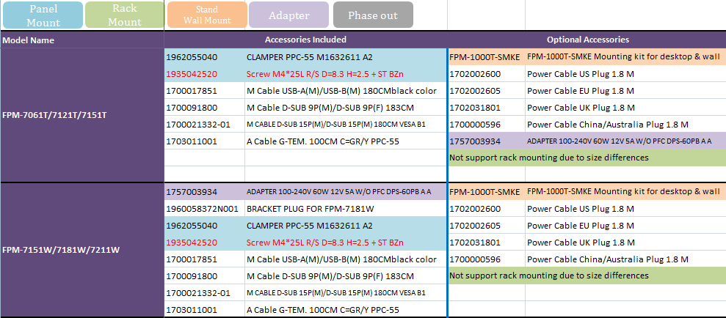
Accessories for FPM-7000 series

